Slide 1
Cleaner Templates

Slide 2
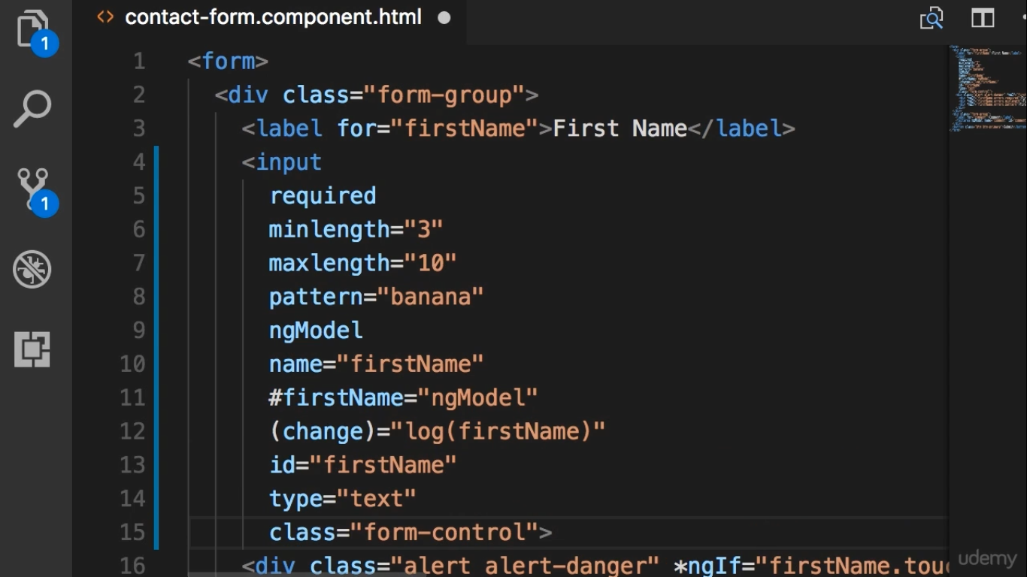
Much easier to the eye

Slide 3
